Slide 1


^{Scikit-Learn for Beginners}
^{(supplementary material)}
Prepared by: Dr Nick Lim
21st June 2023

Slide 2
Overview
Scikit Learn for Regressions: (~30 mins)
Reading data from CSV file
Inspecting Data Frame
Visualizing the Data
Defining a regressor learner
Evaluating a regression model
Using Cross Validation to choose model parameters

Slide 3
Overview
Scikit Learn for Classifications: (~30 mins)
Reading data from CSV file
Inspecting Data Frame
Visualizing the Data
Defining a classifier learner
Evaluating a classifier model

Slide 4
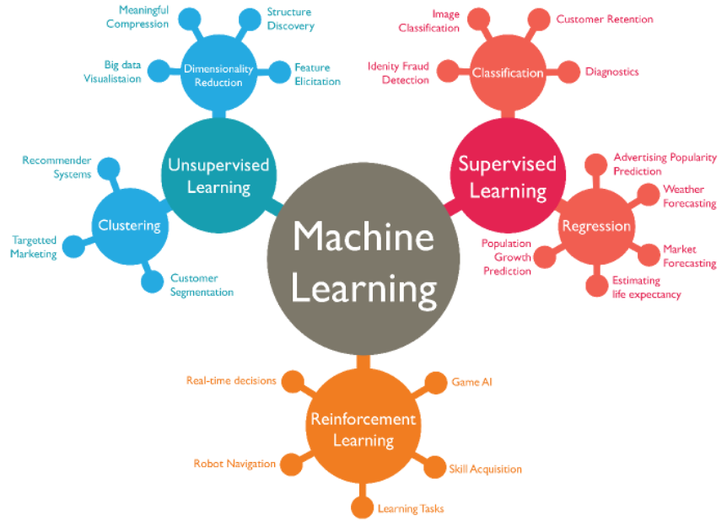
Types of Machine Learning
•Supervised learning:
The system is presented with data which is labelled, which means that each data is tagged with the true label.
•Unsupervised learning:
The system is presented with un-labelled and uncategorized data and the system’s algorithms act on the data without prior training.
•Reinforcement learning:
Algorithms, or agents, learn by interacting with its environment. agent receives rewards by performing correctly and penalties for performing incorrectly.

Slide 5


Slide 8
Links to the colab notebooks
Topic 1: https://shorturl.at/HNk9V
Topic 2: https://shorturl.at/u8DMY

Slide 9
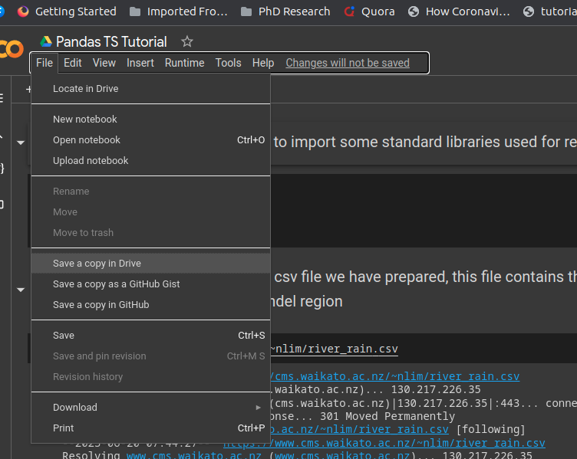
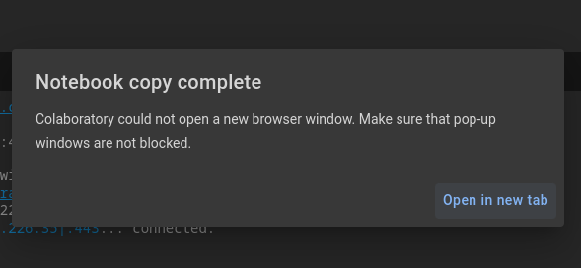
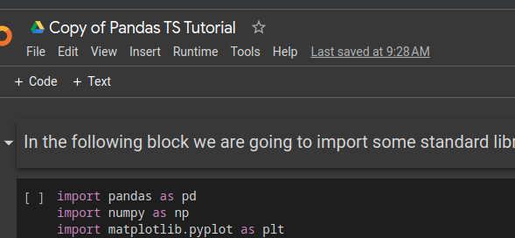
Getting Started
Before you start, click on File -> Save a copy in Drive. This will give you a private copy that you can freely edit and change.

Slide 10
Useful python libraries
Scikit-learn : An all-purpose library for machine learning on python. This library contains a number of helpful helper functions and tools
Pandas : a data processing library that is used for tabular data.
Matplotlib : a basic python plotting library for visualization, while not as powerful at other libraries, matplotlib provides the foundation for these other libraries.
Seaborn: a more powerful library for data visualization. It has in-built pandas support
Numpy: a foundational library for mathematical and matrix operations.

Slide 11

Reading csv files
https://pandas.pydata.org/pandas-docs/version/1.5/reference/api/pandas.read_csv.html

Slide 12
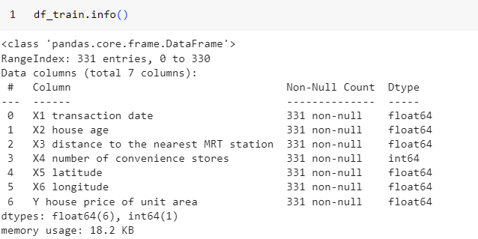
Information on the dataframe

Slide 13
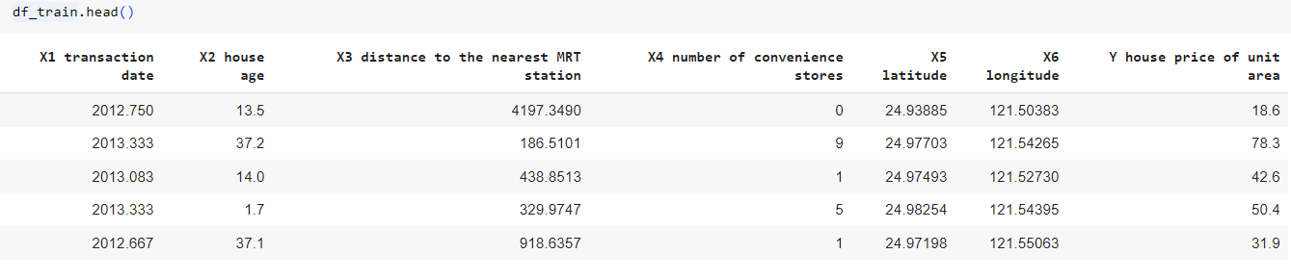
Viewing contents of the data

Slide 14
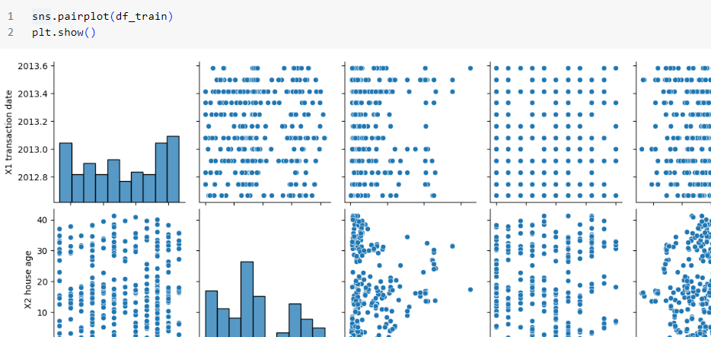
Visualizing the data
https://pandas.pydata.org/pandas-docs/version/1.5/reference/api/pandas.DataFrame.plot.kde.html
https://pandas.pydata.org/pandas-docs/version/1.5/reference/api/pandas.DataFrame.plot.line.html
also look at
https://seaborn.pydata.org/generated/seaborn.scatterplot.html

Slide 15

Defining a linear regression model
https://scikit-learn.org/stable/modules/generated/sklearn.linear_model.LinearRegression.html

Slide 16
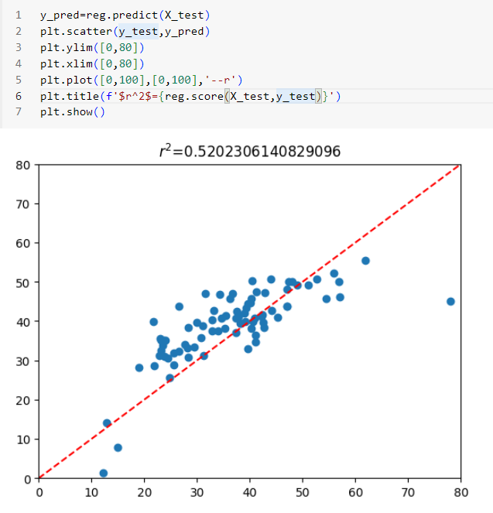
Visualizing and evaluating the model

Slide 17
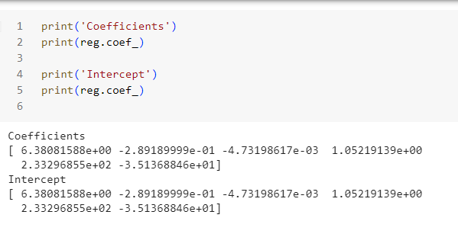
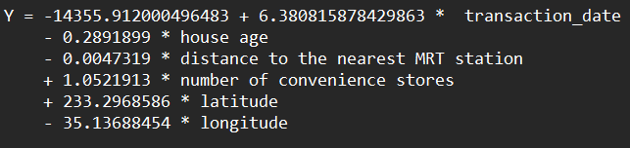
Interpreting the model

Slide 18
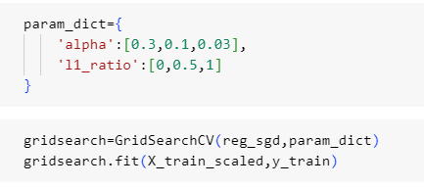
Using Cross Validation to choose model parameters

Slide 19
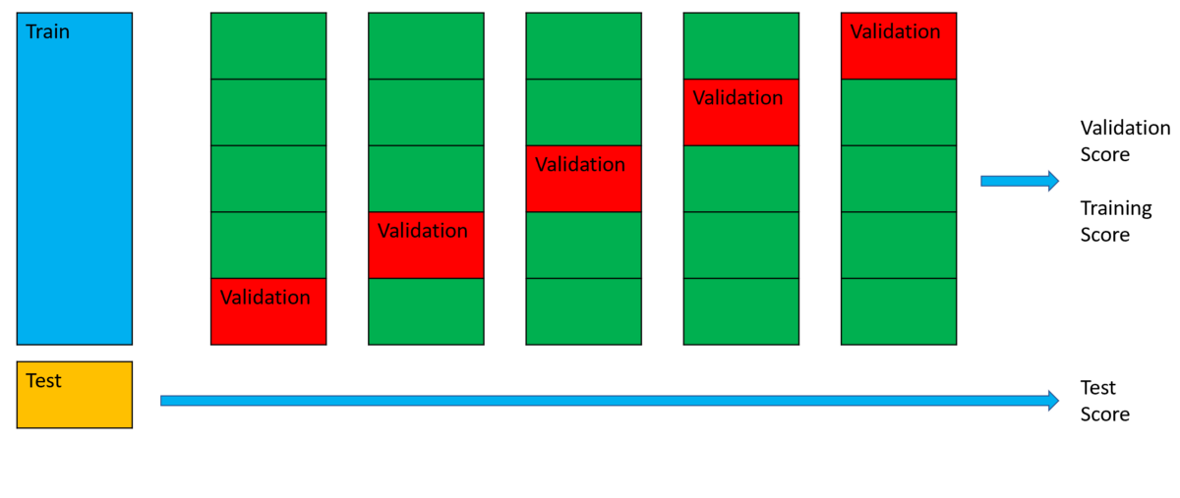

Slide 20
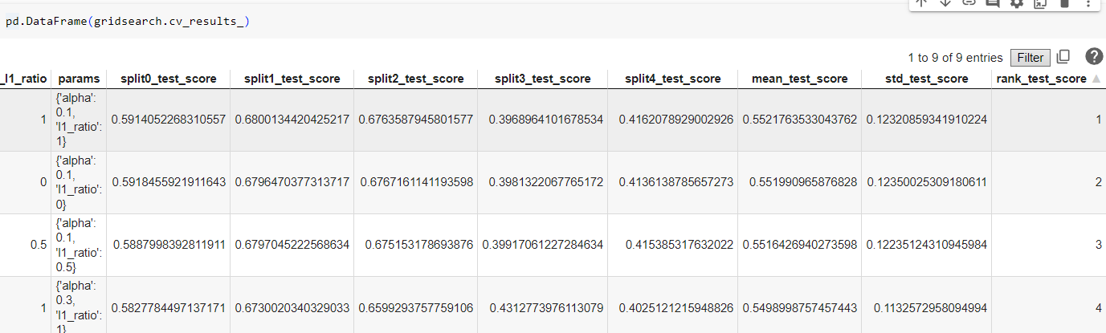

Slide 21
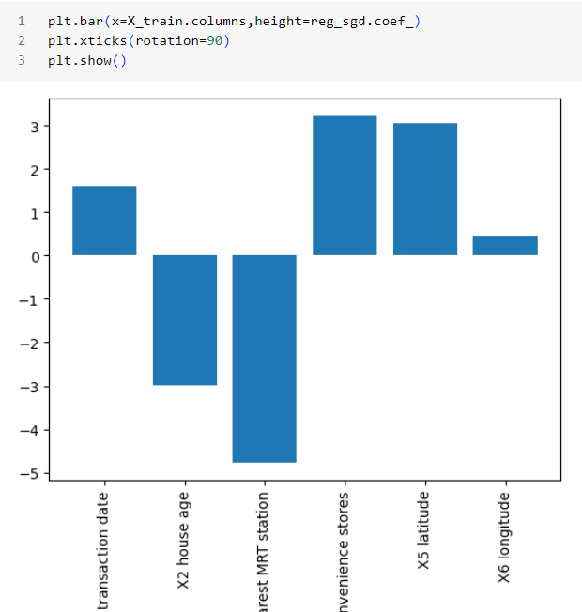

Slide 22
Classifications

Slide 23
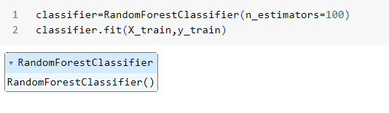
Defining a classifier

Slide 24
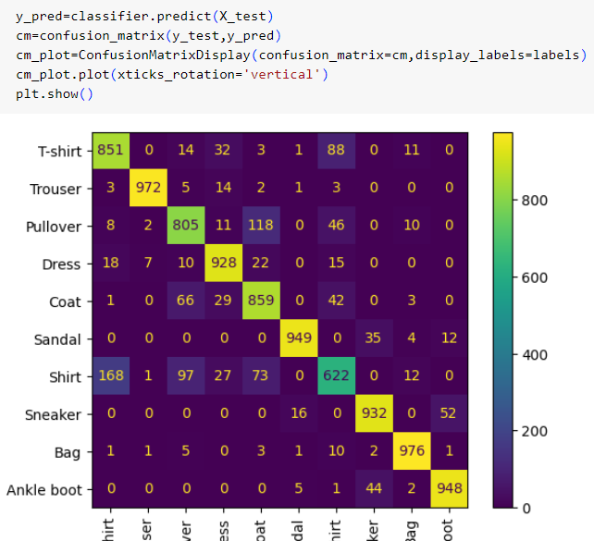
Evaluating a classifier

Slide 25
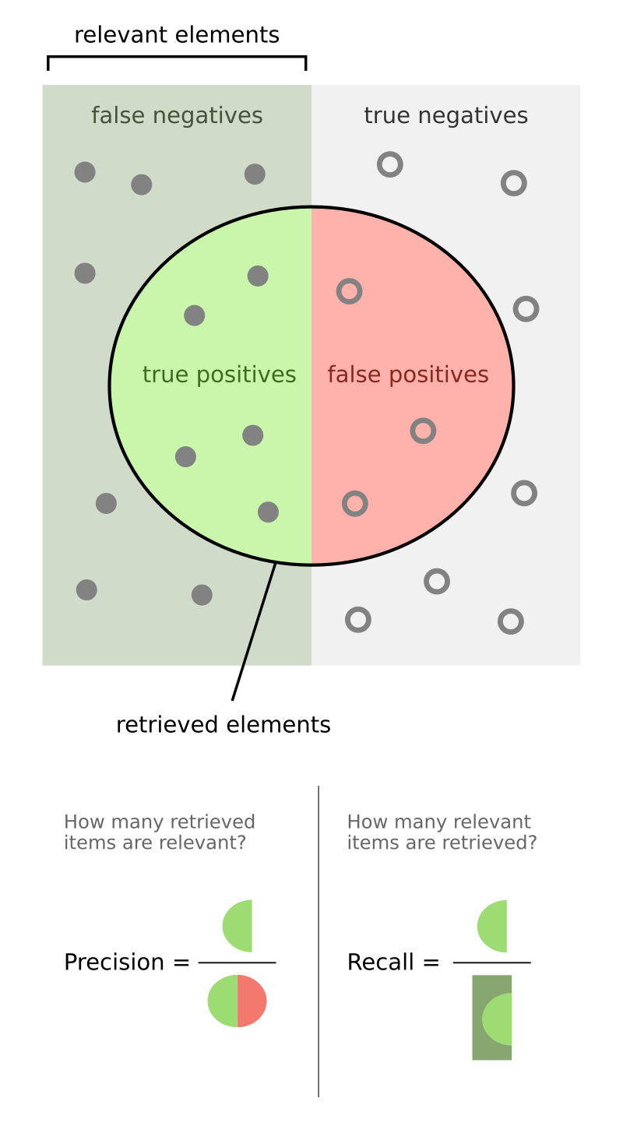
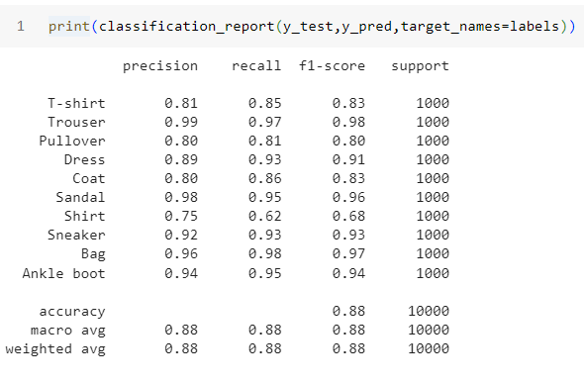
Evaluating a classifier (cont)

Slide 26
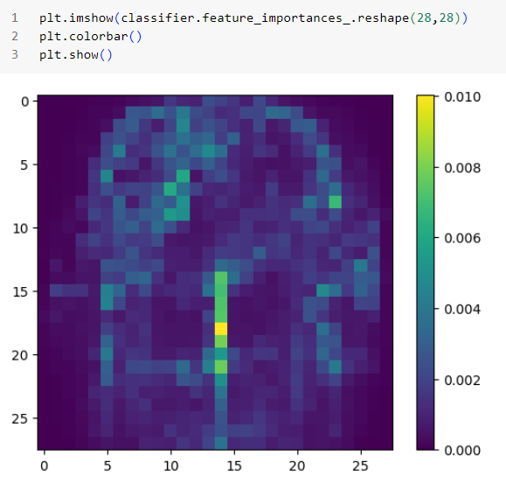
Understanding the classifier

Slide 27
Helpful links
https://pandas.pydata.org/docs/reference/api/pandas.Series.autocorr.html
https://seaborn.pydata.org/api.html
https://pandas.pydata.org/docs/reference/index.html
https://images.datacamp.com/image/upload/v1676302204/Marketing/Blog/Pandas_Cheat_Sheet.pdf
https://campus.datacamp.com/courses/python-for-r-users/pandas?ex=11

